Slide 1
Visualising and Analysing Activities of Daily Living Data to Determine How Assistive Technology Can be Designed to Support Independent Living
BENJAMIN CAVANAGH | 46975373 | SOFTWARE Engineering Major
Supervisor: Dr. Annie Lau
Co-Supervisor: Dr. Shan Chen

Slide 2
Background and Introduction

Slide 3
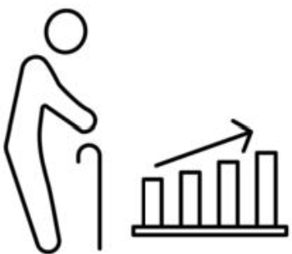
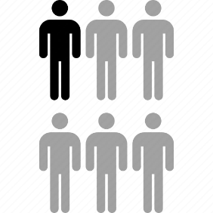
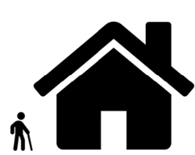


Motivation for Research
Elderly population growing
1 in 6 Australians are 65 or older (Reference: [31])
Many choose to live independently
Concern for their safety increases
Need for AT research, hence overarching project

Slide 4
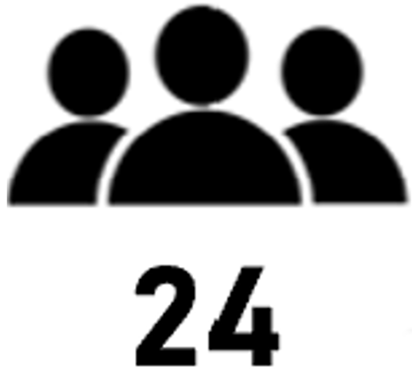
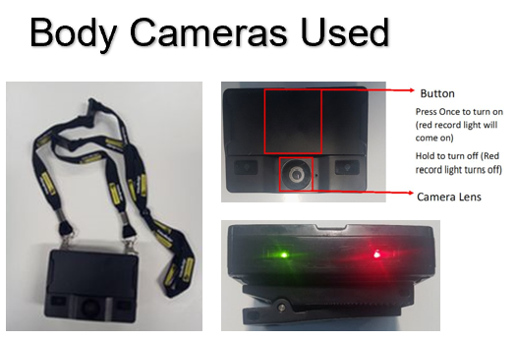
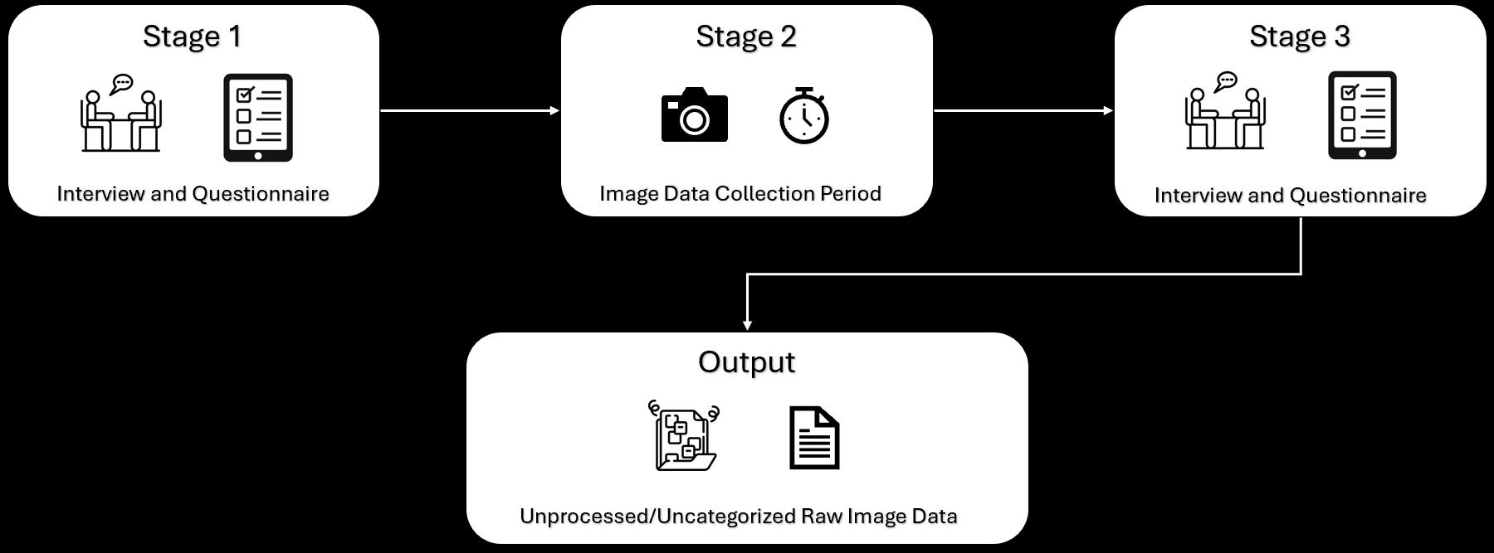
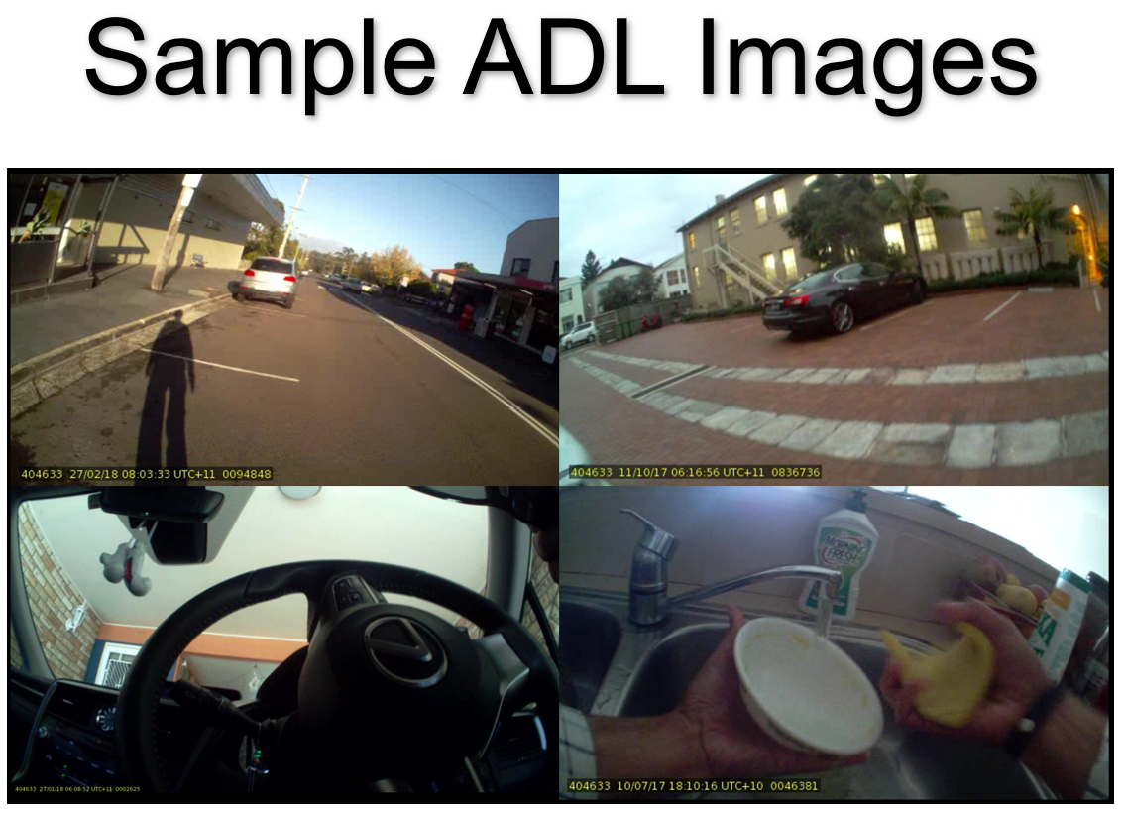
Background – Previous Work
FIRST STUDY (YIN)

Slide 5
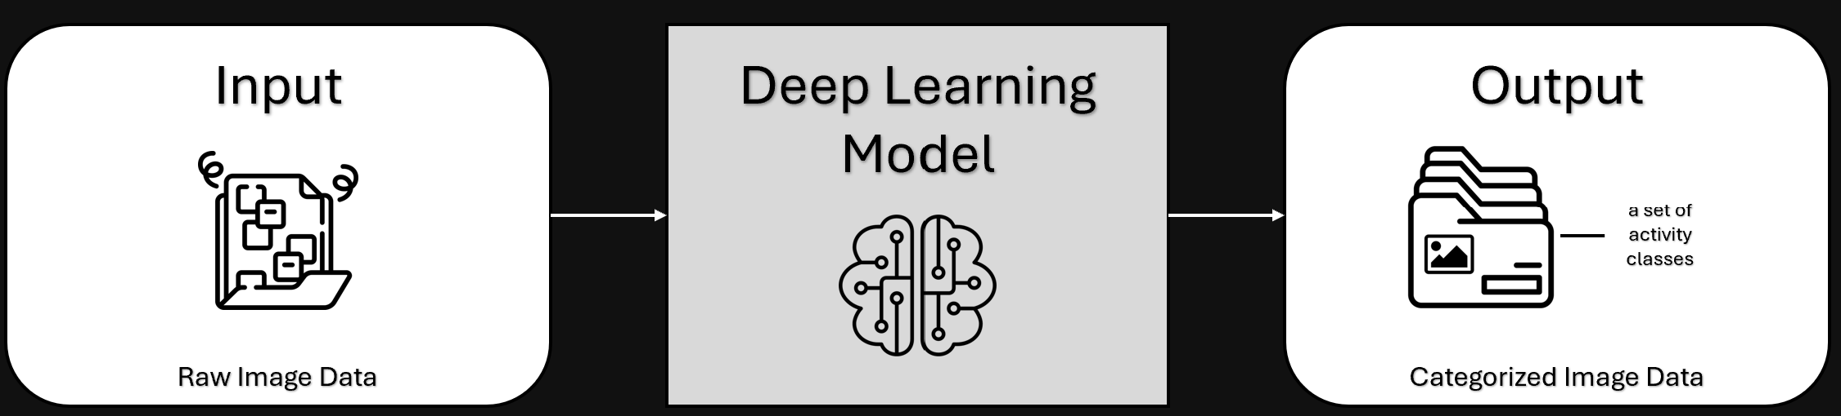
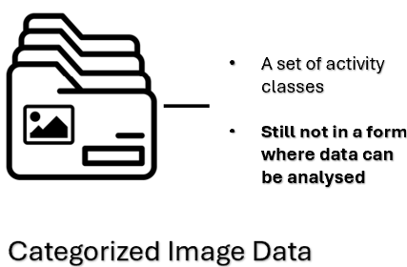
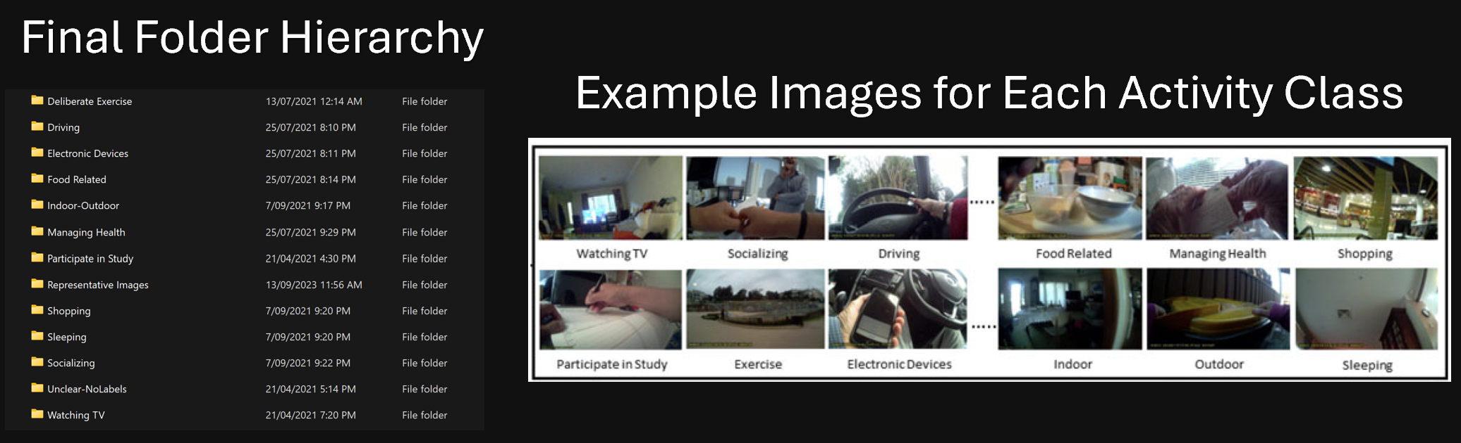
Background – Previous Work
SECOND STUDY (XIONG)
Final Folder Hierarchy
Example Images for Each Activity Class

Slide 6
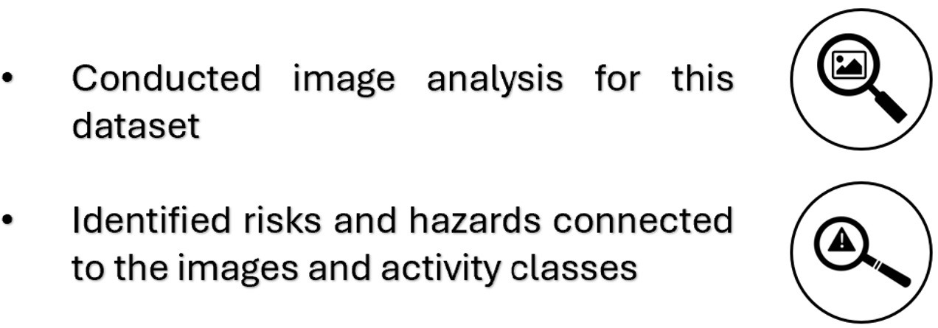
Background – Previous Work
THIRD STUDY (AMMAR)

Slide 7


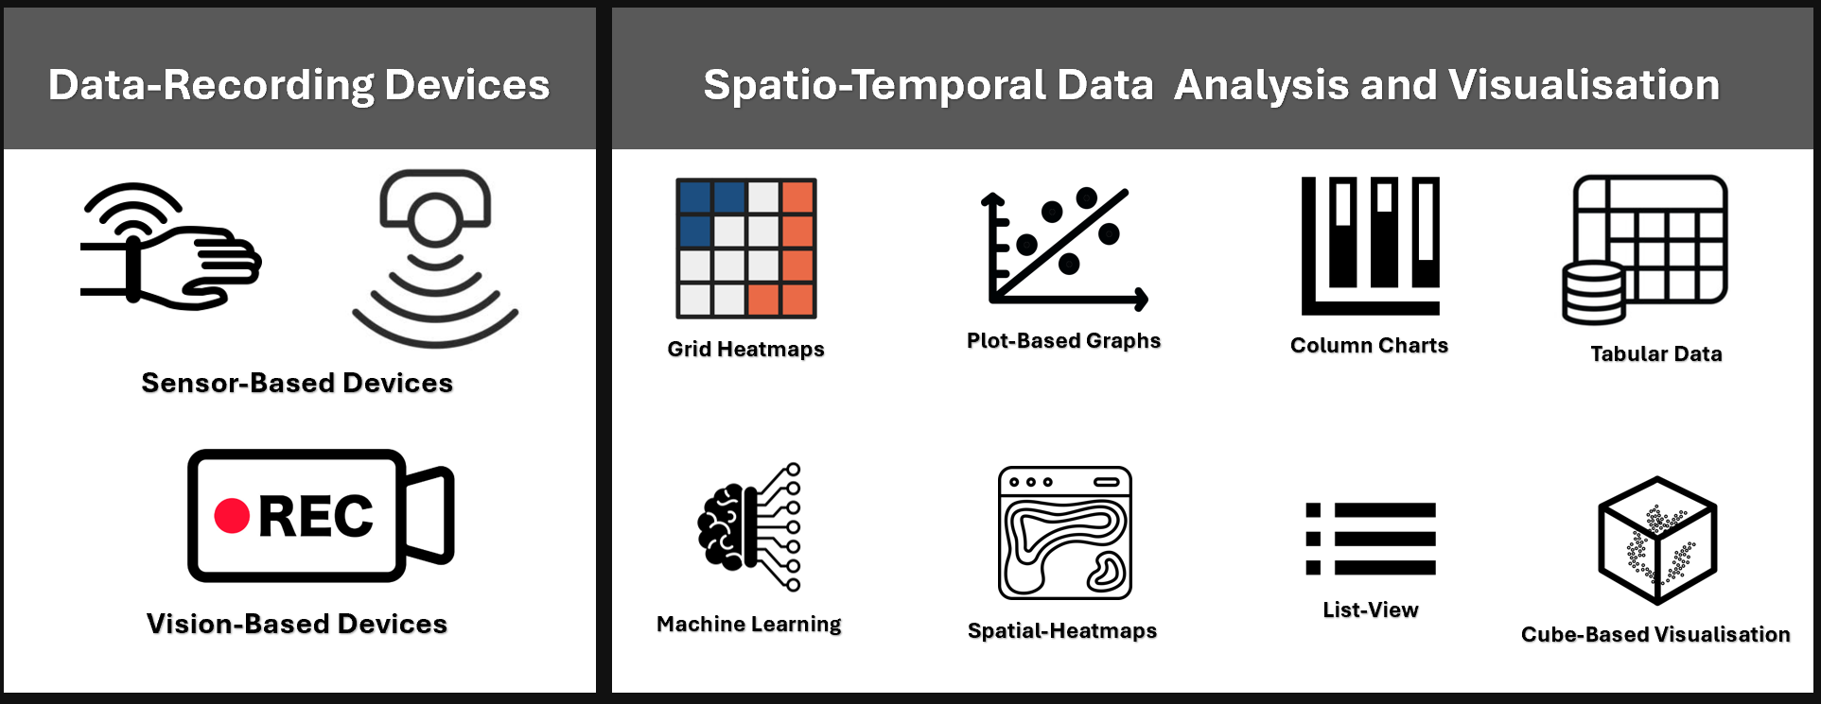
Literature Review
DATA-RECORDING DEVICES | SPATIO-TEMPORAL DATA ANALYSIS AND VISUALISATION

Slide 8

Knowledge Gap
Literature Review conducted
There currently exists much research in these areas individually
However, (to our knowledge) there is a lack of research in how ADL data from wearable body cameras can be visualised and analysed to advance assistive technology to support elderly independent living

Slide 9
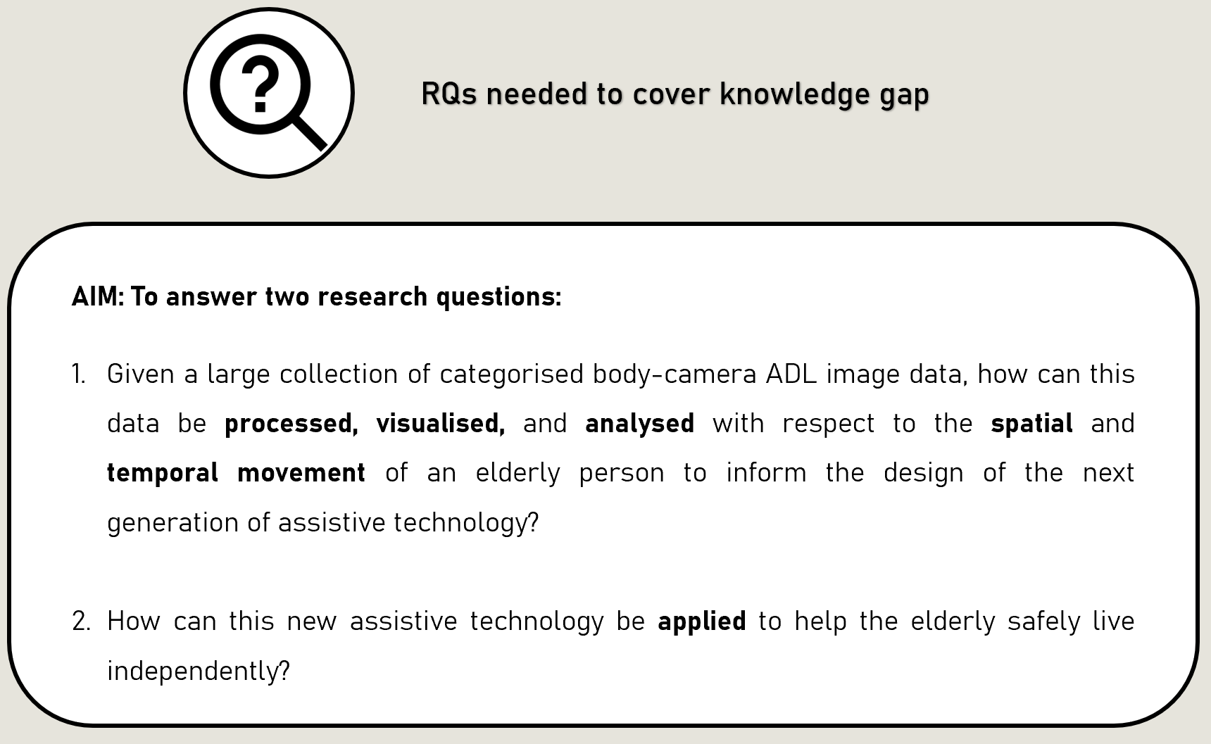
Thesis Aim

Slide 10
Methodology

Slide 11
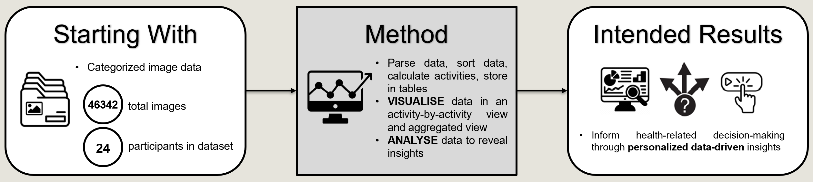
Methodology - Overview
Develop ST data visualisation algorithm
Answer Research Questions
Cover Knowledge Gap
Contribute to Future Design of AT

Slide 12

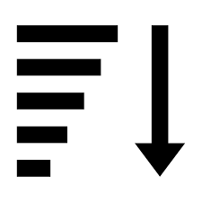

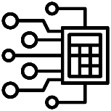
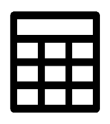
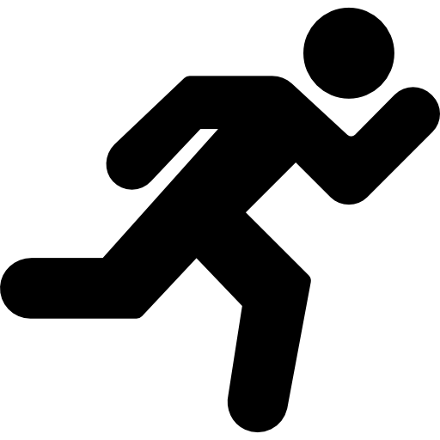

Methodology
DATA EXTRACTION / PROCESSING COMPONENT
x 46342
Parse image data from sources
Sort images chronologically by participant
Identify and remove duplicate and outlier records
Define activities for each participant and create a record for each
Calculate total time per activity class
Export image and activity data into Excel file

Slide 13

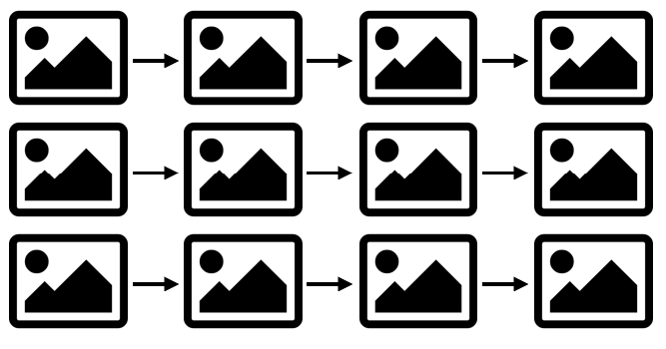
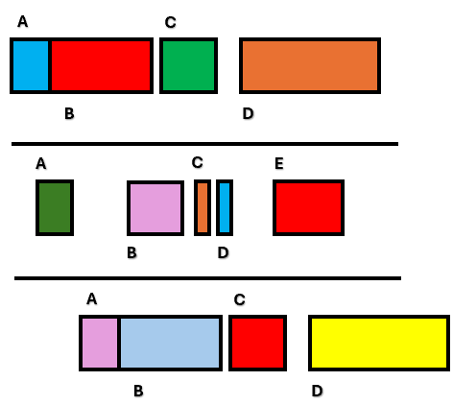
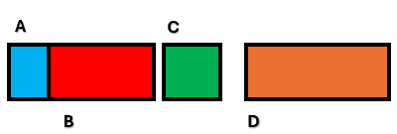
Methodology
DATA visualisation / analysis COMPONENT
Record location and fall hazard data for each activity
Create a “visualisation 1” file for every participant
Create a “visualisation 2” file for every participant
Create one “visualisation 2” file containing all participant data

Slide 14
Methodology
complete process
x 46342

Slide 15
Results

Slide 16
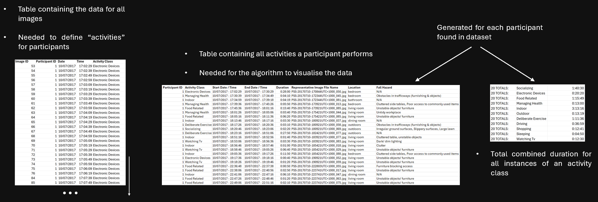
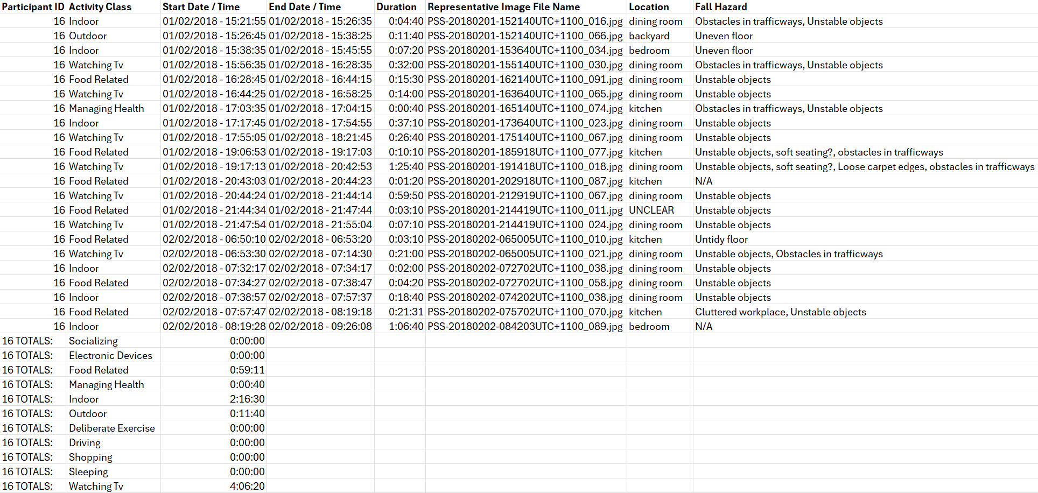
Results
TABULAR RESULTS
Image Table
Activity Tables
Combined Activity Duration Tables
Contains the data for all images
Needed to define “activities” for participants
Contains all activities a participant performs
One table generated for every participant
Needed for the algorithm to visualise the data
Total combined duration for all instances of an activity class
One table generated for every participant
Data must be processed / formatted so that visualisation is possible

Slide 17
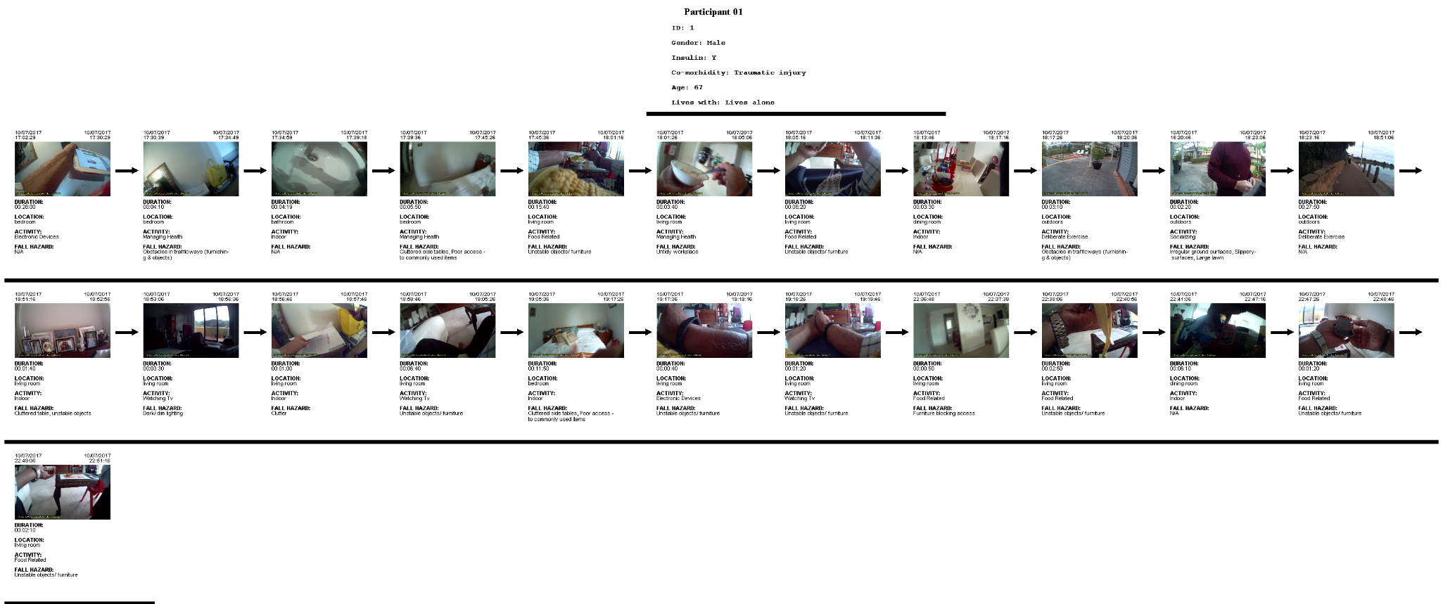

Results
VISUALISATION 1

Slide 18
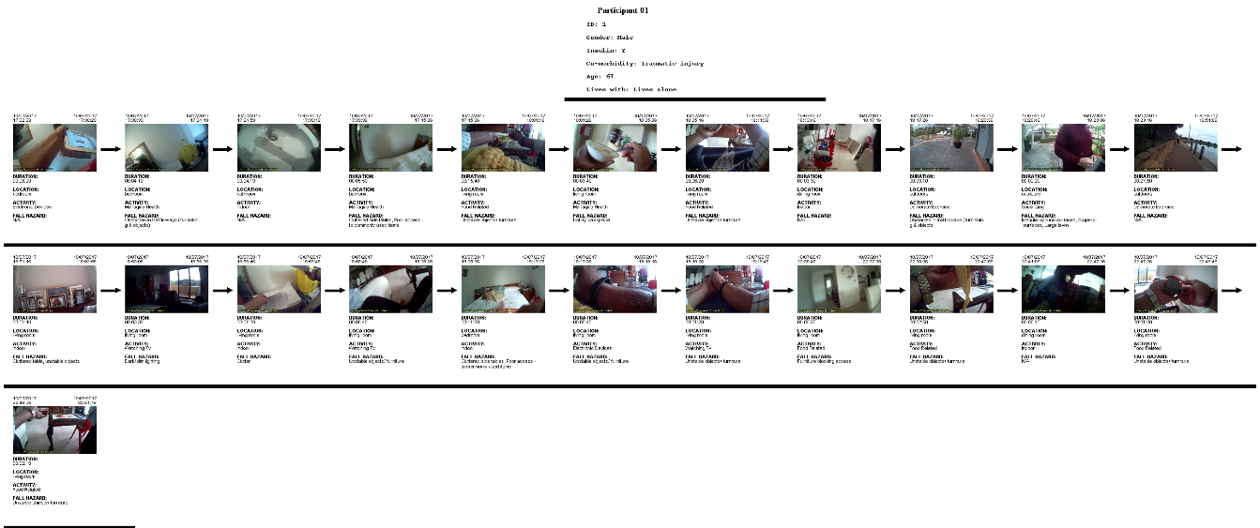
Results
VISUALISATION 1
Activity-by-activity view of the activity record data
Activities shown in the form of representative images connected by arrows
demographic data
start / end time
duration
location
activity class
fall hazard/s

Slide 19
Results
VISUALISATION 1
Focus is on individual participants and events rather than comparing multiple
Breaks down individual activities so that precise data (e.g., duration) can be found quickly
Allows a data analyst to understand the specific conditions of a patient’s environment

Slide 20
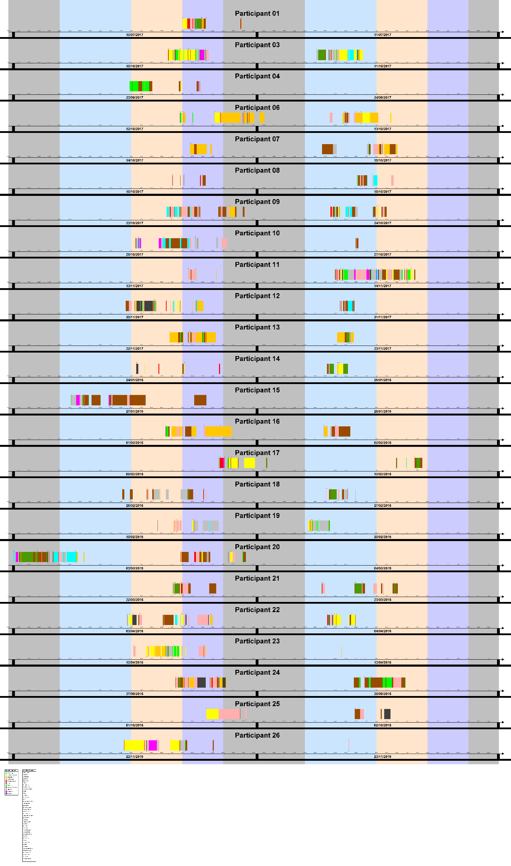
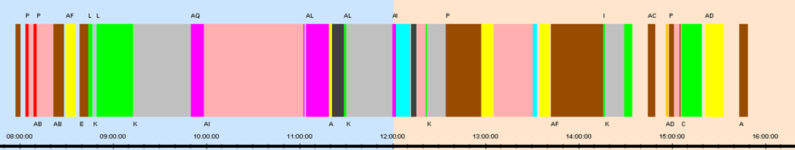
Results
VISUALISATION 2

Slide 21
Results
VISUALISATION 2
Aggregated abstract view of the activity record data
Activities shown in the form of “blocks of time”
Activity classes are colours
Locations are letters
location
part of day
activity class
time of day

Slide 22
Results
VISUALISATION 2
Better understanding of activity frequency and duration
Multiple participants can be compared
Focus is on revealing trends and relationships
Part-of-day patterns
Comparing similar behaviour between multiple participants
Sequential activity patterns
Consistency / inconsistency patterns over a longer period of time
An activity class occurring frequently
An activity class rarely or never occurring
Image

Slide 23
Discussion

Slide 24
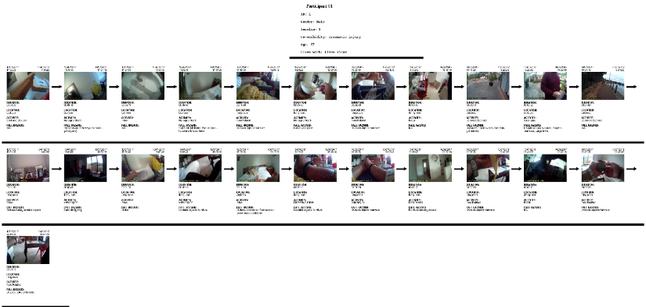
Discussion
APPLICATIONS OF VISUALISATION 1
Fall hazard risk identification
Fall-prevention adjustments can be implemented (removing or controlling the hazards)
High-risk (dangerous) area identification
Helps health providers make plans to spend limited time in these areas
Diet-tracking using “food related” activities
If needed, action can be taken to change regular diet behaviour
Managing a patient’s medical conditions
Helps health providers create personalized plans to recognize and manage their specific needs

Slide 25
Discussion
APPLICATIONS OF VISUALISATION 2
Monitoring engagement in unhealthy activities
Health providers can intervene if required
Tracking physical health goals by monitoring engagement in healthy activities
Health providers can measure progress and change goals if required
Identifying dangerous or risky sequences of activities
Action can be taken if dangerous activity sequences are found (e.g., driving after taking certain types of medication)
Image

Slide 26
Discussion
APPLICATIONS OF VISUALISATION 2
Routine identification
A health provider can check if their patient is taking medication at regular times
If poor routines are found, the patient can be guided to healthier habits
Comparing behaviour of demographic groups
Health providers can assess average age-specific or gender-specific behaviour to more effectively support the needs of their patient
Tracking mental health
Health providers can monitor socializing activities and then make plans to increase their patient’s day-to-day social activities to improve their mental wellbeing
Image

Slide 27
Discussion
IMPLICATIONS – SIGNIFICANCE OF WORK
Spatial and temporal movement of an elderly person in their own home can be recorded and visualised through activity-by-activity and aggregated views
Allows health providers to gain personalized insights into the spatial and temporal aspects of the daily behaviour of their patients
Facilitates customized support for an individual patient’s needs for their own safety when living independently
This informs the future design of assistive technology

Slide 28
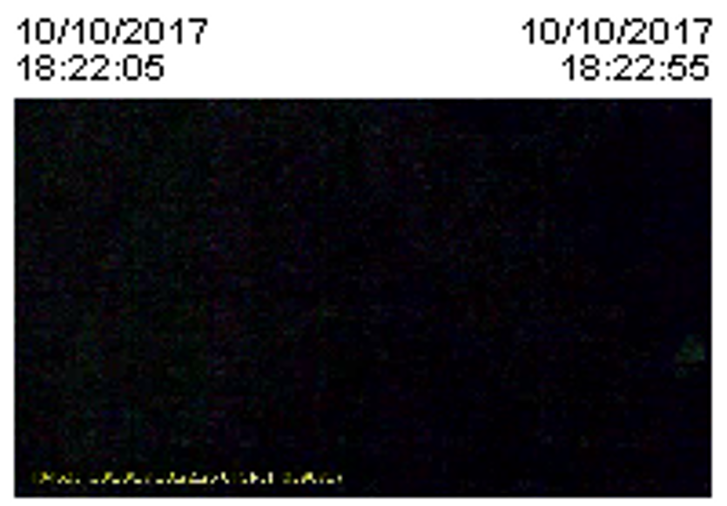
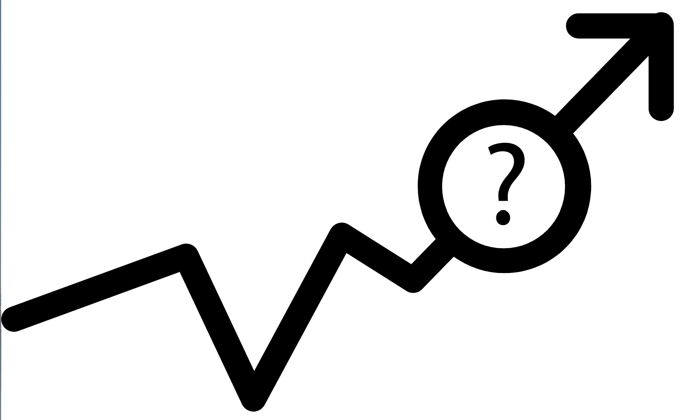
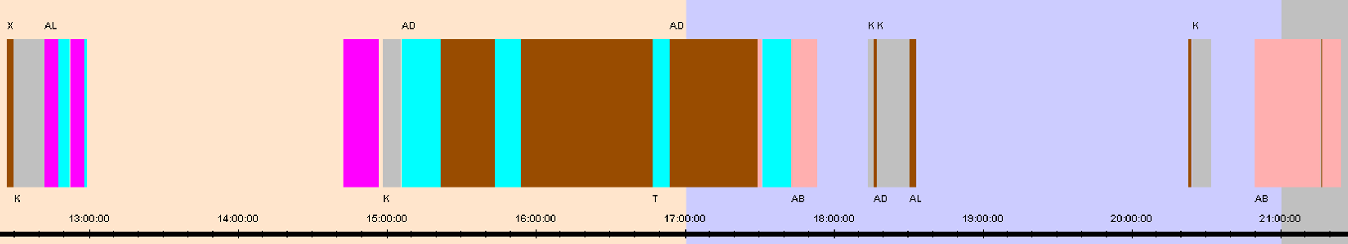
Discussion
LIMITATIONS
GAPS IN DATASET | IMAGE QUALITY | MINIMAL DATASET
Participants were allowed to stop recording or delete images Sometimes they forgot to begin recording again | Poor image quality from dark areas or camera facing a wall | Only 24 participants in the dataset and recording period was less than 24 hours Difficult to determine average behaviour

Slide 29



Discussion
FUTURE WORK
REAL-TIME DATA PROCESSING AND VISUALISATION | AUTOMATING FALL HAZARD AND LOCATION RECOGNITION | ADDITIONAL VISUALISATION METHODS
Deep learning model would also require real-time processing Real-time data and visualisation could be displayed through a web application | Currently, location and fall hazard data must be entered manually Deep learning model could be improved to recognize common features of locations and fall hazards | Improving methods of visualising the participant data improves data analysis process

Slide 30


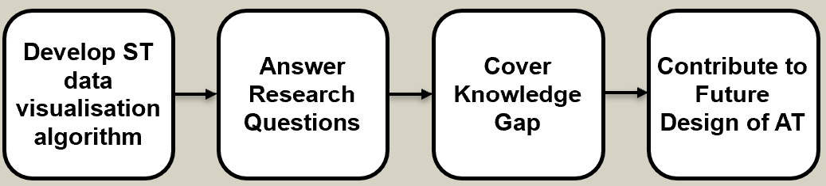
Conclusion
ACHIEVEMENT | FUTURE IMPROVEMENTS
Designed and developed an algorithm to visualise spatio-temporal ADL data through an aggregated and individual activity view Successfully fulfilled aim and objectives | Current solution is not completely ready for regular real-world use Requires automated location and fall hazard detection to be scaled up Requires further testing of larger datasets (with respect to both the total recording duration and number of patients involved) Could be enhanced by real-time data processing/visualisation and implementing additional visualisation methods

Slide 31
Thank You!

Slide 32
References

Slide 33
References
[1] Yin, K., Harms, T., Ho, K., Rapport, F., Vagholkar, S., Laranjo, L., Coiera, E., Gershuny, J., & Lau, A. Y. S. (2018). Patient work from a context and time use perspective: A mixed-methods study protocol. BMJ Open, 8(12), e022163. https://doi.org/10.1136/bmjopen-2018-022163
[2] Xiong, H., Phan, H. N., Yin, K., Berkovsky, S., Jung, J., & Lau, A. Y. S. (2022). Identifying daily activities of patient work for type 2 diabetes and co-morbidities: A deep learning and wearable camera approach. Journal of the American Medical Informatics Association: JAMIA, 29(8), 1400–1408. https://doi.org/10.1093/jamia/ocac071
[3] Ammar, M., (2023). Investigating Risks in Elder Australians: Image Analysis Based on Context and Routines.
[4] Thakur, N., & Han, C. Y. (2021). A review of assistive technologies for activities of daily living of elderly. https://doi.org/10.48550/ARXIV.2106.12183
[5] Cheung, D., Joe, P., Nadeem, M., Akhtar, S., & Aslam, M. H. (2022). Low cost intelligent computer vision based assistive technology for elderly people. Mehran University Research Journal of Engineering and Technology, 41(4), 106. https://doi.org/10.22581/muet1982.2204.11
[6] Clap ́es, A., Pardo, `A., Pujol Vila, O., & Escalera, S. (2018). Action detection fusing multiple Kinects and a WIMU: An application to in-home assistive technology for the elderly. Machine Vision and Applications, 29(5), 765–788. https://doi.org/10.1007/s00138-018-0931-1
[7] Ranieri, C. M., MacLeod, S., Dragone, M., Vargas, P. A., & Romero , R. A. F. (2021). Activity recognition for ambient assisted living with videos, inertial units and ambient sensors. Sensors, 21(3), 768. https://doi.org/10.3390/s21030768
[8] Holthe, T., Halvorsrud, L., & Lund, A. (2022). Digital assistive technology to support everyday living in community-dwelling older adults with mild cognitive impairment and dementia. Clinical Interventions in Aging, Volume 17, 519–544. https://doi.org/10.2147/CIA.S357860
[9] Camp, N., Lewis, M., Hunter, K., Johnston, J., Zecca, M., Di Nuovo, A., & Magistro, D. (2021). Technology used to recognize activities of daily living in community-dwelling older adults. International Journal of Environmental Research and Public Health, 18(1), 163. https://doi.org/10.3390/ijerph18010163

Slide 34
References
[10] Patel, A., & Shah, J. (2020). Real-time human behaviour monitoring using hybrid ambient assisted living framework. Journal of Reliable Intelligent Environments, 6(2), 95–106. https://doi.org/10.1007/s40860-020-00100-7
[11] Ahanathapillai, V., Amor, J. D., & James, C. J. (2015). Assistive technology to monitor activity, health and wellbeing in old age: The wrist wearable unit in the USEFIL project. Technology and Disability, 27(1,2), 17–29. https://doi.org/10.3233/TAD-150425
[12] Chifu, V. R., Pop, C. B., Demjen, D., Socaci, R., Todea, D., Antal, M., Cioara, T., Anghel, I., & Antal, C. (2022). Identifying and monitoring the daily routine of seniors living at home. Sensors, 22(3), 992. https://doi.org/10.3390/s22030992
[13] Lee, R., Luo, J., Le, C. H., Phan, P. A., Le, T., & Le, M. H. (2018). Assistive technologies for the older people: Physical activity monitoring and fall detection. In T. Vo Van, T. A. Nguyen Le, & T. Nguyen Duc (Eds.), 6th International Conference on the Development of Biomedical Engineering in Vietnam (BME6) (pp. 661–665). Springer. https://doi.org/10.1007/978-981-10-4361-1113
[14] Bellagente, P., Crema, C., Depari, A., Ferrari, P., Flammini, A., Lanfranchi, G., Lenzi, G., Maddiona, M., Rinaldi, S., Sisinni, E., & Ziliani, G. (2018). Remote and non-invasive monitoring of elderly in a smart city context. 2018 IEEE Sensors Applications Symposium (SAS), 1–6. https://doi.org/10.1109/SAS.2018.8336732
[15] Kim, K., Jalal, A., & Mahmood, M. (2019). Vision-based human activity recognition system using depth silhouettes: A smart home system for monitoring the residents. Journal of Electrical Engineering & Technology, 14(6), 2567–2573. https://doi.org/10.1007/s42835-019-00278-8
[16] De Miguel, K., Brunete, A., Hernando, M., & Gambao, E. (2017). Home camera-based fall detection system for the elderly. Sensors, 17(12), 2864. https://doi.org/10.3390/s17122864
[17] Martinez-Martin, E., & Costa, A. (2021). Assistive technology for elderly care: An overview. IEEE Access, 9, 92420–92430. https://doi.org/10.1109/ACCESS.2021.3092407
[18] Ong, S. K., Shen, Y., Zhang, J., & Nee, A. Y. C. (2011). Augmented reality in assistive technology and rehabilitation engineering. In B. Furht (Ed.), Handbook of Augmented Reality (pp. 603–630). Springer. https://doi.org/10.1007/978-1-4614-0064-6_28
[19] Ando, B., Baglio, S., Castorina, S., Crispino, R., & Marletta, V. (2020). An assistive technology solution for user activity monitoring exploiting passive rfid. Sensors, 20(17), 4954. https://doi.org/10.3390/s20174954

Slide 35
References
[20] Aloulou, H., Mokhtari, M., Tiberghien, T., Biswas, J., Phua, C., Kenneth Lin, J. H., & Yap, P. (2013). Deployment of assistive living technology in a nursing home environment: Methods and lessons learned. BMC Medical Informatics and Decision Making, 13(1), 42. https://doi.org/10.1186/1472-6947-13-42
[21] Yu, C., & He, Z.-C. (2017). Analysing the spatial-temporal characteristics of bus travel demand using the heat map. Journal of Transport Geography, 58, 247–255. https://doi.org/10.1016/j.jtrangeo.2016.11.009
[22] Olawoyin, A. M., Leung, C. K., & Cuzzocrea, A. (2021). Privacy-preserving publishing and visualization of spatial-temporal information. 2021 IEEE International Conference on Big Data (Big Data), 5420–5429. https://doi.org/10.1109/BigData52589.2021.9671564
[23] Dhont, M., Tsiporkova, E., Tourw ́e, T., & Gonz ́alez-Deleito, N. (2020). Visual analytics for extracting trends from spatio-temporal data. In V. Lemaire, S. Malinowski, A. Bagnall, T. Guyet, R. Tavenard, & G. Ifrim (Eds.), Advanced Analytics and Learning on Temporal Data (pp. 122–137). Springer International Publishing. https://doi.org/10.1007/978-3-030-65742-0_9
[24] Surian, D., Kim, V., Menon, R., Dunn, A. G., Sintchenko, V., & Coiera, E. (2019). Tracking a moving user in indoor environments using Bluetooth low energy beacons. Journal of Biomedical Informatics, 98, 103288. https://doi.org/10.1016/j.jbi.2019.103288
[25] Bach, B., Dragicevic, P., Archambault, D., Hurter, C., & Carpendale, S. (2017). A descriptive framework for temporal data visualizations based on generalized space-time cubes. Computer Graphics Forum, 36(6), 36–61. https://doi.org/10.1111/cgf.12804
[26] Liu, D., Xu, P., & Ren, L. (2019). Tpflow: Progressive partition and multidimensional pattern extraction for large-scale spatio-temporal data analysis. IEEE Transactions on Visualization and Computer Graphics, 25(1), 1–11. https://doi.org/10.1109/TVCG.2018.2865018
[27] Petrich, L., Jin, J., Dehghan, M., & Jagersand, M. (2022). A quantitative analysis of activities of daily living: Insights into improving functional independence with assistive robotics. 2022 International Conference on Robotics and Automation (ICRA), 6999–7006. https://doi.org/10.1109/ICRA46639.2022.9811960
[28] Stucki, R. A., Urwyler, P., Rampa, L., M ̈uri, R., Mosimann, U. P., & Nef, T. (2014). A web-based non-intrusive ambient system to measure and classify activities of daily living. Journal of Medical Internet Research, 16(7), e3465. https://doi.org/10.2196/jmir.3465
[29] How to view & sort your apple watch workout history. (2018, May 23). https://www.iphonelife.com/content/how-to-view-sort-your-apple-watch-workout-history

Slide 36
References
[30] Record a workout on my samsung watch. (n.d.). Samsung Au. Retrieved May 9, 2024, from https://www.samsung.com/au/support/mobile-devices/record-a-workout-on-samsung-watch/
[31] Older australians, demographic profile. (2023, June 28). Australian Institute of Health and Welfare. https://www.aihw.gov.au/reports/older-people/older-australians/contents/demographic-profile
[32] Aussies are living longer than ever before, but will this trend continue? (2023, July 11). Australian Institute of Health and Welfare. https://www.aihw.gov.au/news-media/media-releases/2023/2023-july/aussies-are-living-longer-than-ever-before-but-wil
[33] Bargiotas, I., Wang, D., Mantilla, J., Quijoux, F., Moreau, A., Vidal, C., Barrois, R., Nico lai, A., Audiffren, J., Labourdette, C., Bertin-Hugaul, F., Oudre, L., Buffat, S., Yelnik, A., Ricard, D., Vayatis, N., & Vidal, P.-P. (2023). Preventing falls: The use of machine learning for the prediction of future falls in individuals without history of fall. Journal of Neurology, 270(2), 618–631. https://doi.org/10.1007/s00415-022-11251-3
[34] iang, S., Ferreira, J., & Gonzalez, M. C. (2012). Discovering urban spatial-temporal struc ture from human activity patterns. Proceedings of the ACM SIGKDD International Workshop on Urban Computing, 95–102. https://doi.org/10.1145/2346496.2346512
[35] Ahmadian, N., Nazarahari, M., Whittaker, J. L., & Rouhani, H. (2020). Quantification of triple single-leg hop test temporospatial parameters: A validated method using body-worn sensors for functional evaluation after knee injury. Sensors, 20(12), 3464. https://doi.org/10.3390/s20123464
[36] Zhou, Y., Zia Ur Rehman, R., Hansen, C., Maetzler, W., Del Din, S., Rochester, L., Hor tob´ agyi, T., & Lamoth, C. J. C. (2020). Classification of neurological patients to identify fallers based on spatial-temporal gait characteristics measured by a wearable device. Sensors, 20(15), 4098. https://doi.org/10.3390/s20154098
[37] Zhang, K., Liu, W., Zhang, J., Li, Z., & Liu, J. (2023). A fall risk assessment model for community-dwelling elderly individuals based on gait parameters. IEEE Access, 11, 120857–120867. https://doi.org/10.1109/ACCESS.2023.3327091
[38] Chen, M., Wang, H., Yu, L., Yeung, E. H. K., Luo, J., Tsui, K.-L., & Zhao, Y. (2022). A systematic review of wearable sensor-based technologies for fall risk assessment in older adults. Sensors (Basel, Switzerland), 22(18), 6752. https://doi.org/10.3390/s22186752
[39] Bet, P., Castro, P. C., & Ponti, M. A. (2019). Fall detection and fall risk assessment in older person using wearable sensors: A systematic review. International Journal of Medical Informatics, 130, 103946. https://doi.org/10.1016/j.ijmedinf.2019.08.006

Slide 37
References
[40] Lockhart, T. E., Soangra, R., Yoon, H., Wu, T., Frames, C. W., Weaver, R., & Roberto, K. A. (2021). Prediction of fall risk among community-dwelling older adults using a wearable system. Scientific Reports, 11(1), 20976. https://doi.org/10.1038/s41598-021-00458-5
[41] Kang, H., Lee, C., & Kang, S. J. (2023). A smart device for non-invasive ADL estimation through multi-environmental sensor fusion. Scientific Reports, 13(1), 17246. https://doi.org/10.1038/s41598-023-44436-5
[42] Steinert, A., Sattler, I., Otte, K., R¨ ohling, H., Mansow-Model, S., & M¨uller-Werdan, U. (2020). Using new camera-based technologies for gait analysis in older adults in comparison to the established gaitrite system. Sensors, 20(1), 125. https://doi.org/10.3390/s20010125
[43] Ponte, S. V. (2022). Increased fall risk evaluation in the elderly: A video-based approach for gait analysis [masterThesis]. https://repositorio.ul.pt/handle/10451/53903
[44] Ohnishi, K., Kanehira, A., Kanezaki, A., & Harada, T. (2016). Recognizing activities of daily living with a wrist-mounted camera (arXiv:1511.06783). arXiv. https://arxiv.org/abs/1511.06783
[45] Aminu, M., & Ahmad, N. A. (2020). Complex chemical data classification and discrimination using locality preserving partial least squares discriminant analysis. ACS Omega, 5(41), 26601–26610. https://doi.org/10.1021/acsomega.0c03362
[46] How to sort an arraylist of objects by property in java? (2020, December 28). GeeksforGeeks. https://www.geeksforgeeks.org/how-to-sort-an-arraylist-of-objects-by-property-in-java/

Slide 38
Q&A

Slide 39
Q&A - Examples

Slide 40
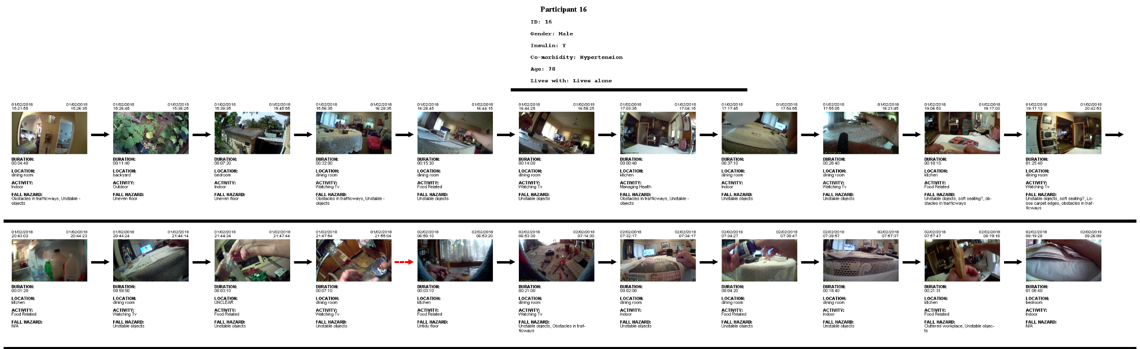
Q&A - Examples

Slide 41
Q&A - Examples

